Slide 1

Smart CanSat
Real-Time Environmental & Motion Monitoring System

Slide 2

The Challenge
Limited Access to Aerospace Data Systems
Students and academic teams face significant barriers when exploring atmospheric science and aerospace engineering. Professional-grade data collection systems are prohibitively expensive, and opportunities for hands-on telemetry experience remain scarce.
Our project addresses three critical gaps: the need for affordable atmospheric monitoring solutions, accessible student-level aerospace platforms, and real-time wireless data transmission capabilities.

Slide 3

Our Solution
Compact Design
Real-Time Monitoring
Wireless Telemetry
Cylindrical CanSat prototype fits standard deployment mechanisms while housing all sensors and electronics
Continuous environmental and motion data collection during flight.
433 MHz RF transmission sends structured data packets to ground station for live analysis
Sensors
Arduino
RF Module
Ground Station
The system creates a complete data pipeline from atmospheric measurement to real-time visualization, demonstrating practical aerospace telemetry principles at student budget levels.

Slide 4





Hardware Architecture
Arduino Uno
Flight Controller
DHT11
Temp & Humidity
MPU6050
Motion Sensor
RF 433 MHz
Transmission
Power Supply
9V Battery

Slide 5

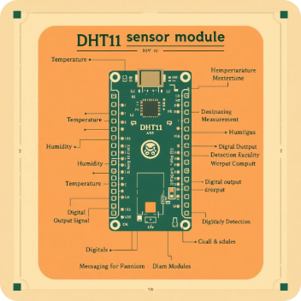
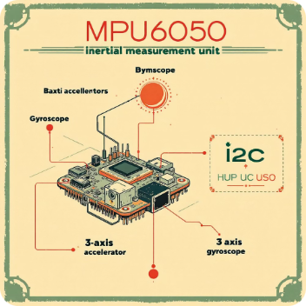

Key Components Breakdown
Arduino Uno
DHT11 Sensor
MPU6050 IMU
RF Module
ATmega328P processor
16 MHz clock speed
Embedded C++ programming
Temperature measurement
Humidity detection
Digital output signal
3-axis accelerometer
3-axis gyroscope
I2C communication protocol
433 MHz frequency
Real-time telemetry
Wireless data link

Slide 6
Software & Programming
Development Stack
I2C Communication
1 Hz Sampling Rate
Structured Packets
Built with Embedded C++ on Arduino IDE for efficient real-time processing and reliable sensor integration
Balanced data collection frequency optimizes telemetry bandwidth and battery life
Formatted telemetry frames include sensor ID, timestamp, and checksum for data integrity
Two-wire protocol enables MPU6050 sensor data exchange with minimal pin usage

Slide 7
Working Mechanism
Power ON
1
System initialization and voltage regulation check
2
Sensor Init
DHT11 and MPU6050 calibration and communication test
Data Acquisition
3
Environmental and motion parameters sampled continuously
4
Processing
Digital filtering and packet formatting in real-time
Transmission
5
RF module broadcasts telemetry to ground station
The complete cycle executes every second, creating a continuous stream of atmospheric and motion data from launch through recovery. This automated workflow requires no operator intervention during flight.

Slide 8

Deployment & Safety
Drop System
Drone-based aerial deployment provides controlled release altitude and consistent initial conditions for testing.
Controlled Descent
Parachute system ensures safe descent velocity while maintaining stable orientation for continuous sensor readings.
Impact Protection
Foam padding and cylindrical enclosure protect electronics during landing. Secured component mounting prevents internal damage from deceleration forces.

Slide 9
Challenges & Solutions
Technical Challenges
Engineering Solutions
Signal Interference
Sensor Noise
Antenna Optimization
Data Averaging
Vibration introduces measurement errors
Moving average filter reduces noise artifacts
Environmental RF noise affects telemetry reliability
Quarter-wave antenna tuning improves signal strength
Power Stability
Structural Integrity
Voltage Regulation
Secured Mounting
Voltage fluctuations impact sensor accuracy
Linear regulator maintains stable 5V supply
Hot glue and mechanical fasteners prevent movement
Component mounting under flight stress

Slide 10


Conclusion & Future Scope
Scalable Design
Low-Cost Solution
Modular architecture supports additional sensors and enhanced capabilities
Complete system under $50 makes aerospace accessible to student teams
Next Phase Development
BMP280 barometric sensor for altitude measurement and vertical velocity
GPS module integration for position tracking and trajectory mapping
SD card data logging as backup to telemetry system
Custom PCB design to reduce size, weight, and improve reliability
Our Smart CanSat demonstrates practical, scalable, and affordable aerospace telemetry innovation for the next generation of engineers.

